Slide 1
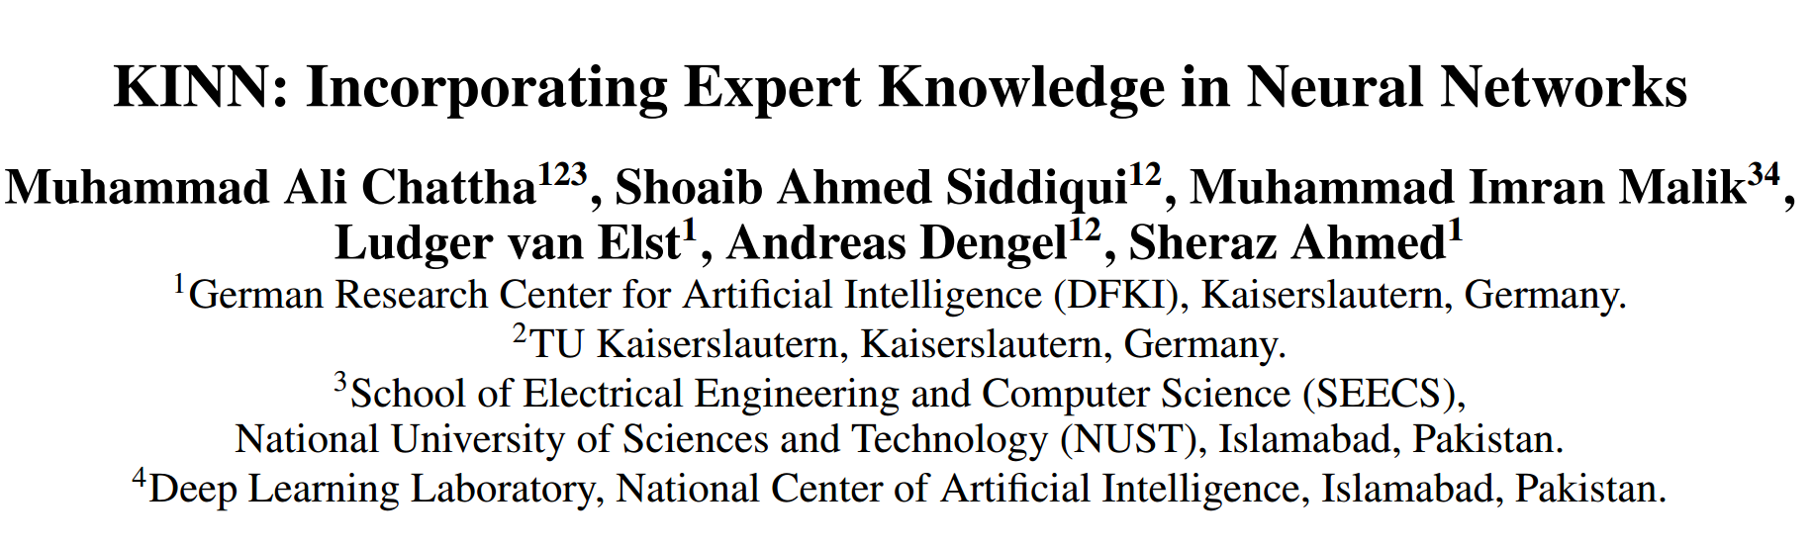

Slide 2


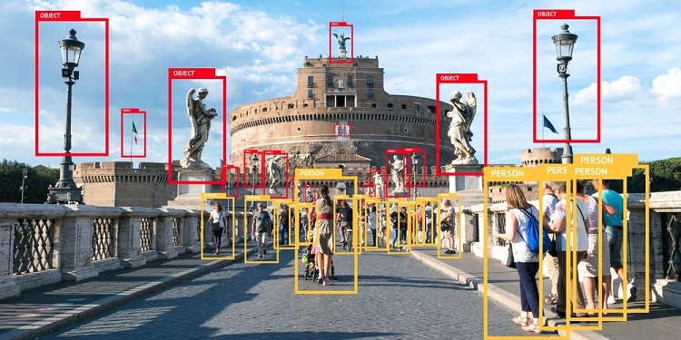
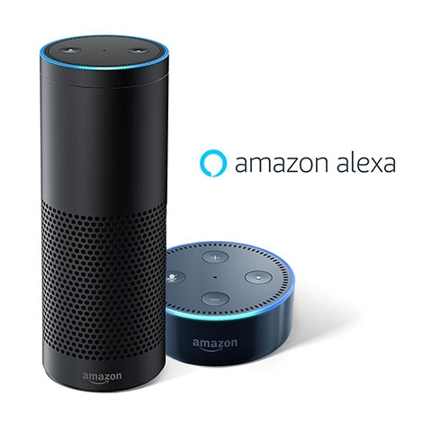
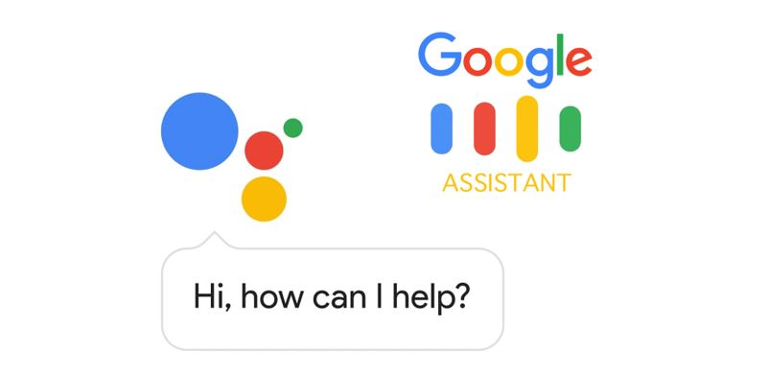
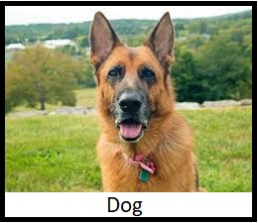
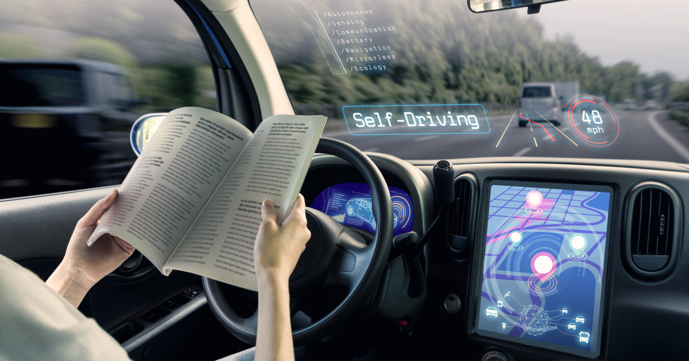


Neural Networks have achieved amazing performance in many domains
Document Analysis
Text generation
Object detection and Recognition
Natural language Processing
Image Classification
AI bots
Self driving cars
Disclaimer: No copyright infringement is intended
Notes:
Latin documentum, which denotes a "teaching" or "lesson":

Slide 3
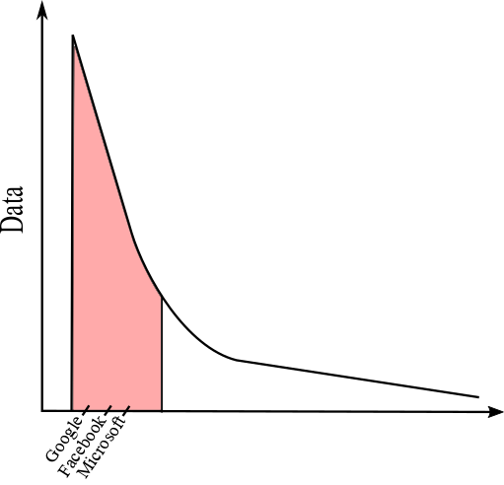
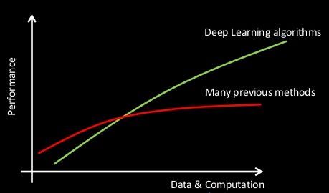

Neural Networks are data hungry
Neural networks require a lot of data to optimize its parameters
Allowed Giants , Google, Facebook, Microsoft etc. to leverage the power of neural nets
Most Industries do not have the resource of data
They rely on experts
Knowledge based system
Statistical method
Adam Coates at AI Frontiers: AI for 100 Million People with Deep Learning

Slide 4
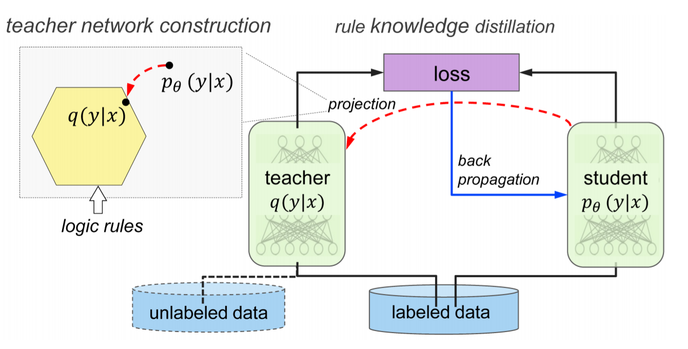
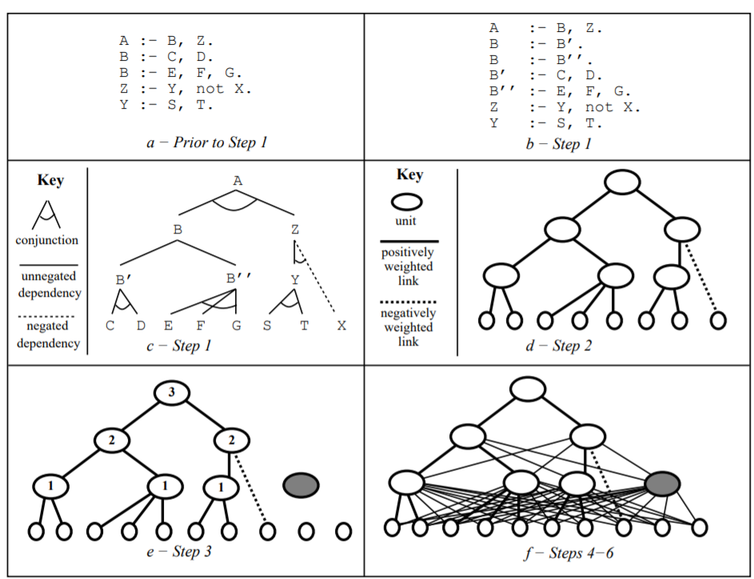
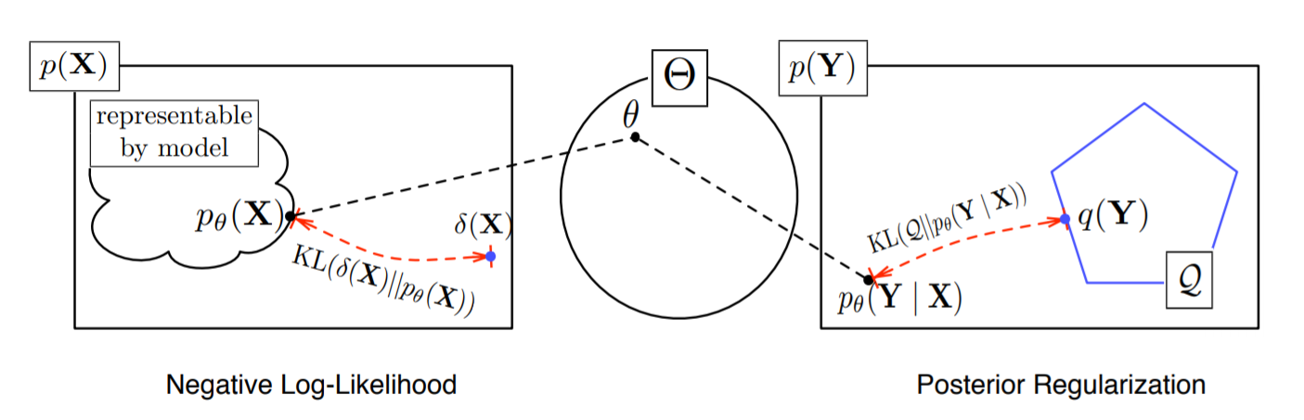
Current knowledge Incorporating Techniques
Knowledge Distillation
Expert network produces soft predictions​
DNN tries to emulate those predictions
Posterior Regularization
Constraints on posterior expectations
Restrict the space of posteriors
Rule based Neural Networks
Expert knowledge is defined by propositional logic​.
NN architecture is designed to have one-to-one correspondence with elements of the rule set
Zhiting hu et.al., ACL, 2016
Ghanchev et.al.,2010
GG towel et.al.,1990

Slide 5








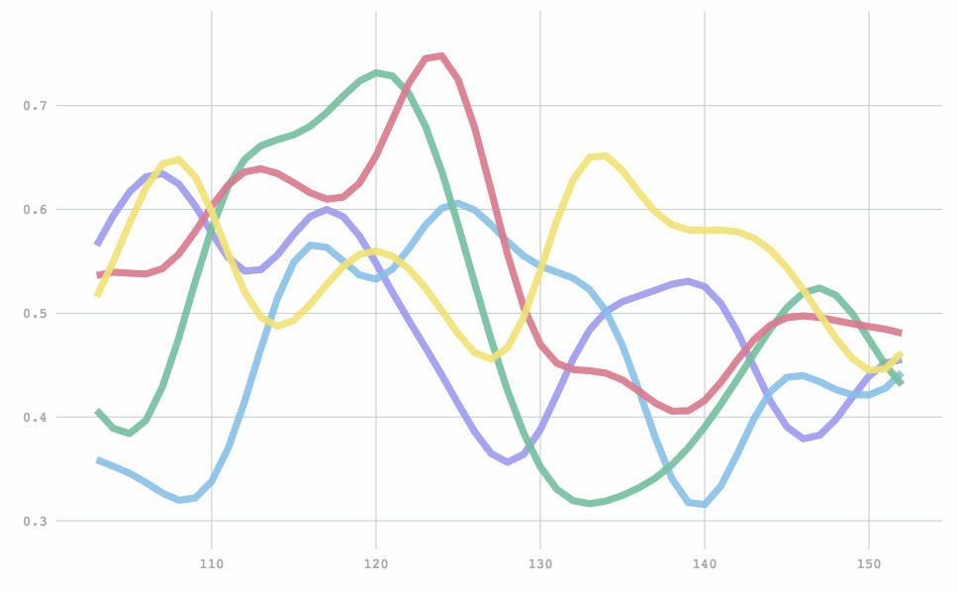










Time Series Analysis is of vital importance due to high impact in various domains
Product tracking
Supply and demand
Fault detection
Forecasting
Smart grid
Forecasting

Slide 6

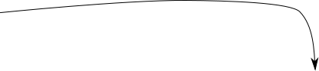
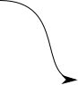
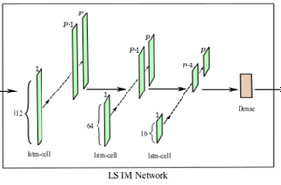
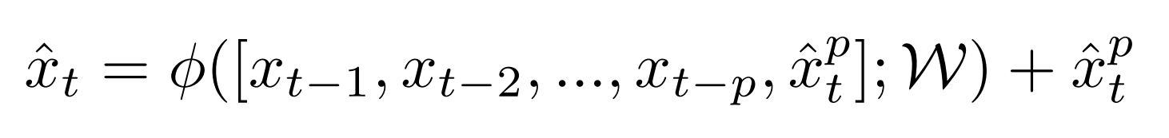
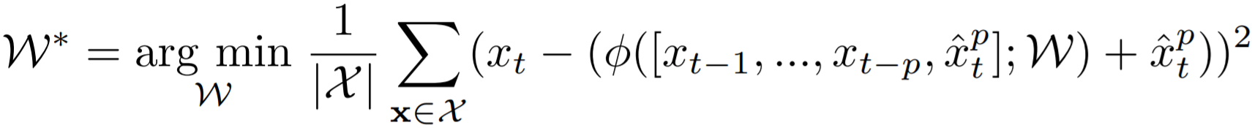
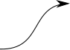
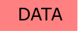
KINN: Knowledge Integrated Neural Network
Knowledge incorporation technique for time series forecasting
Knowledge is incorporated in a residual scheme
Parametric equation
Objective
Human Intelligence: Earl Hunt

Slide 7
Experimental Setup
Dataset
Caltrans PeMS​
Vehicular Traffic on Richards Ave from Jan till March 2016
Grouped into 30 mins window​
One-step ahead prediction
70/10/20 Trian, Validation and Test split
Commonly used method: SARIMA as an expert method
LSTM model as Neural Network
http://www.stat.ucdavis.edu/~clarkf/

Slide 8
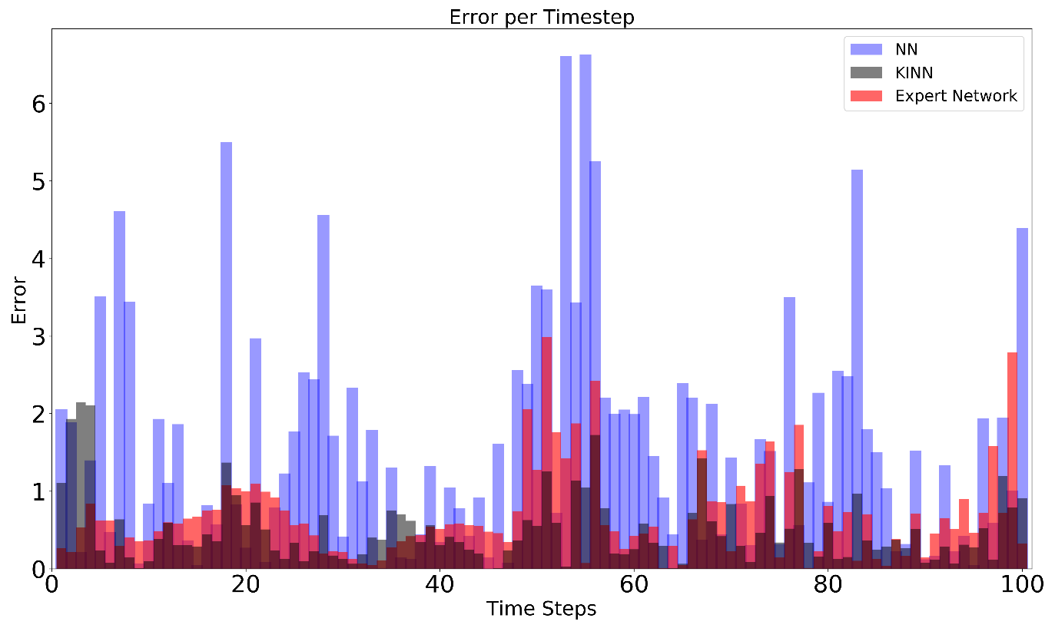
KINN significantly outperforms both expert and neural network when tested on complete dataset
Accurate Expert and full training set
Baseline NN MSE: 5.90​
Baseline Expert model MSE : 1.24​
KINN MSE: 0.74

Slide 9
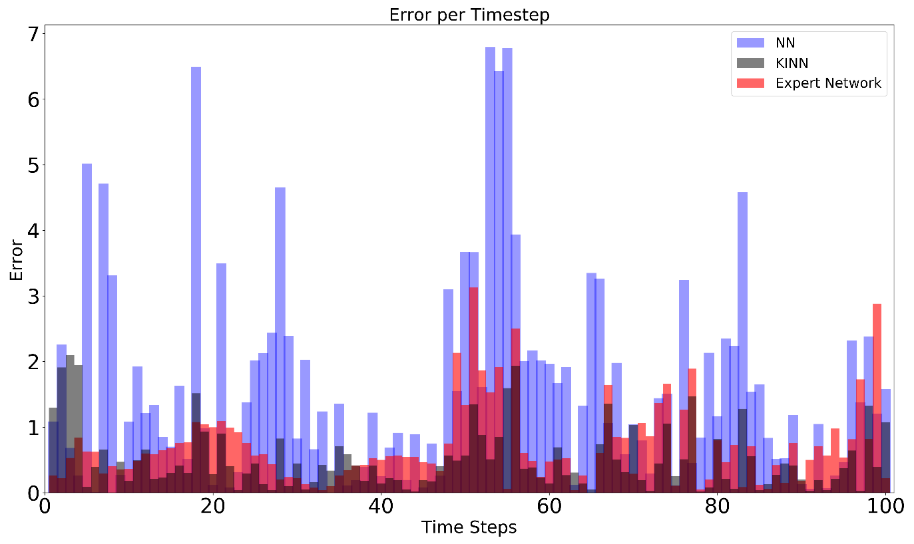
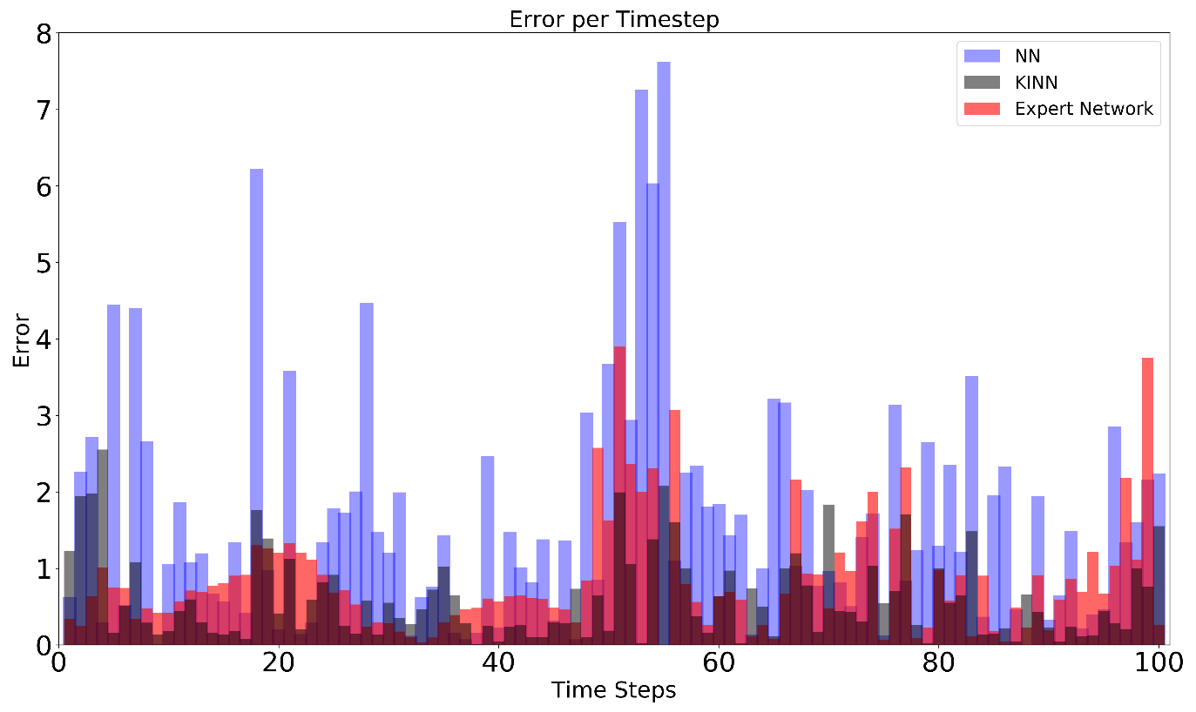
KINN still outperforms both expert and neural network when tested on reduced dataset
Trained over 50% of the training set​
Baseline NN MSE: 6.36​
Baseline Expert model MSE : 1.52​
KINN MSE: 0.89 ​
​ Trained over 10% of the training set​
Baseline NN MSE: 6.68​
Baseline Expert model MSE : 2.67
KINN MSE: 1.53

Slide 10
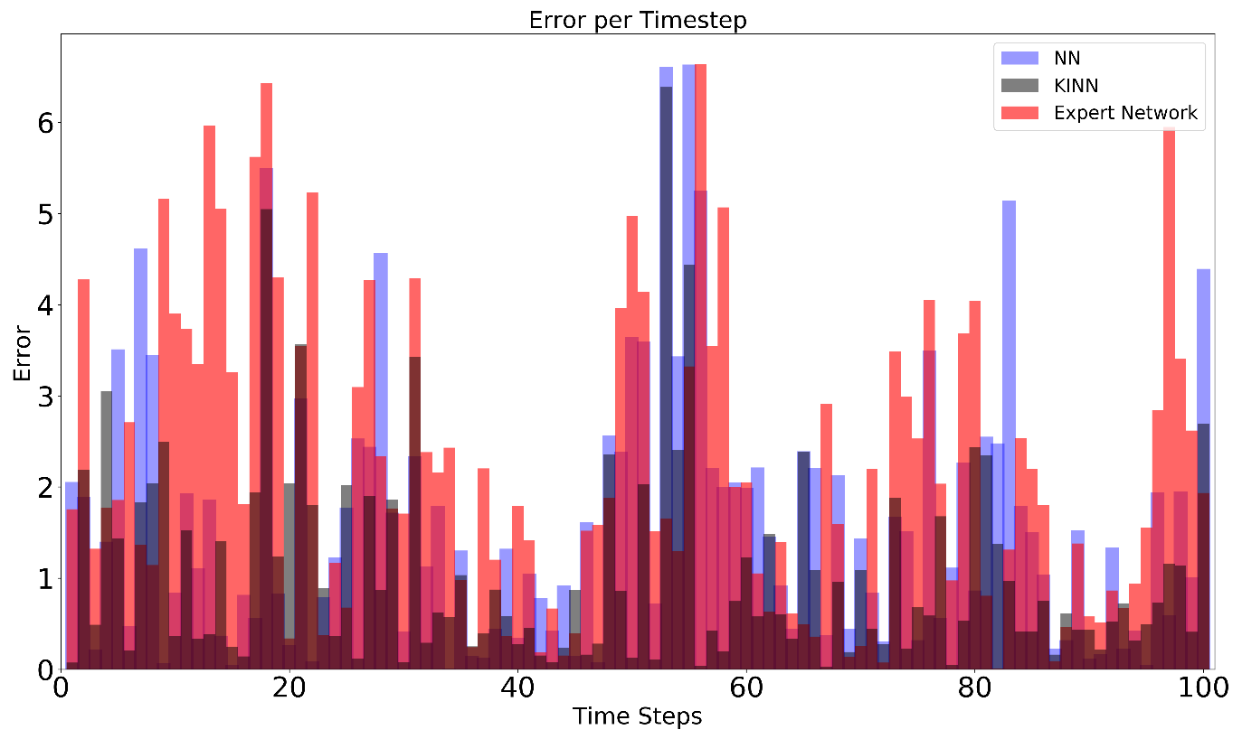
KINN does not require accurate predictions by the expert model
Noisy expert perdictions and full training set
Baseline NN MSE: 5.90​
Baseline Expert model MSE : 7.81
KINN MSE: 3.09

Slide 11
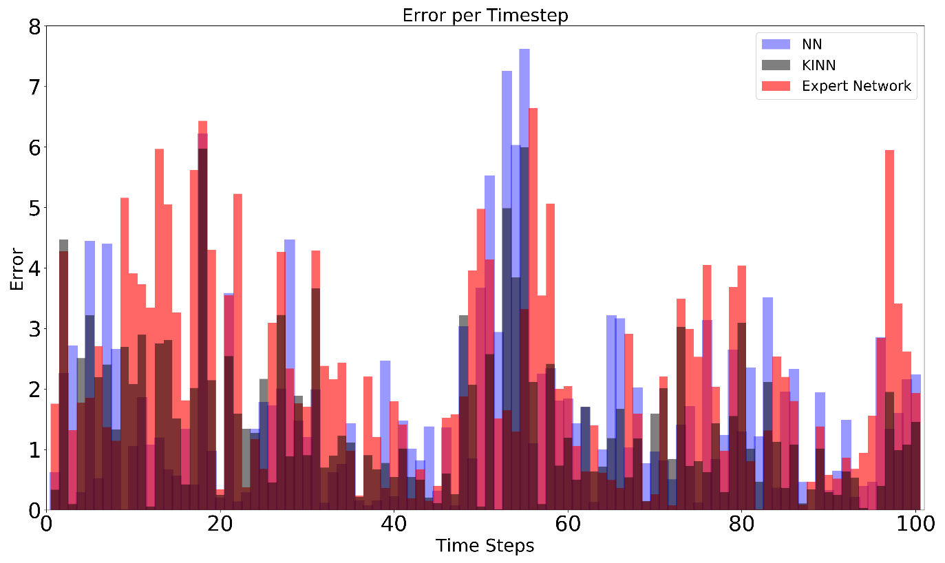
KINN is robust enough to handle poor expert predictions with reduced dataset
Trained over 10% of the training set with noisy expert predictions
Baseline NN MSE: 6.68​
Baseline Expert model MSE : 7.81
KINN MSE: 3.73

Slide 12
KINN is not adversely effected if one domain does not contain any information
Full training set with zero expert predictions
Baseline NN MSE: 5.90​
Baseline Expert model MSE : 621
KINN MSE: 5.92
Full training set with garbage values from expert
Baseline NN MSE: 5.90​
Baseline Expert model MSE : 9.04
KINN MSE: 5.91

Slide 13
Experiments Summarized
Experiment | Description | % of training data | MSE
 |  |  | DNN | Expert Network | KINN
1 | Accurate Expert & Full training set | 100 | 5.90 | 1.24 | 0.74
2 | Accurate Expert & reduced training set | 50 | 6.36 | 1.52 | .89
 |  | 10 | 6.68 | 2.67 | 1.53
3 | Noisy expert & Full training set | 100 | 5.90 | 7.81 | 3.09
4 | Noisy expert & reduced training set | 10 | 6.68 | 7.81 | 3.73
5 | Zero expert pred. & full training set | 100 | 5.90 | 621 | 5.92
 | Delayed expert pred. & full training set | 100 | 5.90 | 9.04 | 5.91

Slide 14
Conclusion
KINN achieves three key advantages
Significant reduction in data required for training
Provision of a lower bound on the performance
Faster convergence of model parameters

Slide 15
Future work
Multi step ahead forecasting
Testing on benchmark time series datasets
Better conditioning on expert network

Slide 16
Thank You

